Slide 1
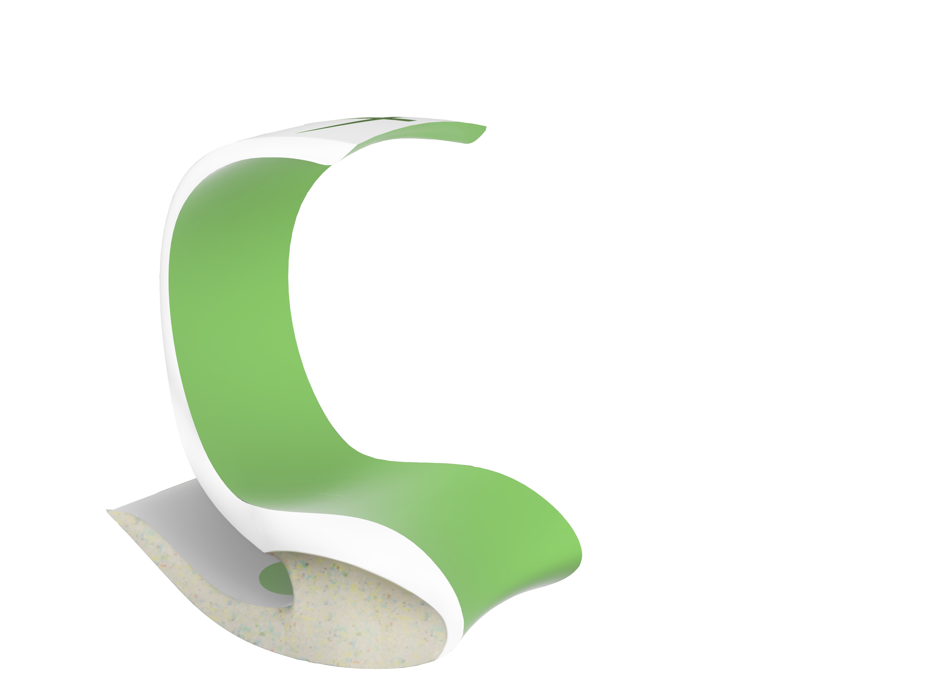
The credal of nature
Liangxizhe 2003607e TD03
Notes:
Hi everyone im liang xizhe welcome to my presentation of the credal of nature.

Slide 2
Problem
People, especially youths, are losing interest in embracing nature nowadays. Mostly, 7 out of 10 Singaporeans youths are occupied with a stressful lifestyle. Subsequently, stress-related mental disorders will be developed along the accumulation of stress level. Based on my research, visiting nature park is the most efficient way to help youths to de-stress mentally and physically.
youth
stress
park
Notes:
So the problem that I'm trying to solve is to help ppl, especially youth, to destress by reconnecting themselves with nature in parks

Slide 3
DESIGN STATEMENT
To design a seat that can help users to release stress by rocking and involving the sense of hearing from the rustling gravel in parks.
Notes:
And the solution is to design a seat that helps users to release stress by allowing them to rock on it and involving their listening by mimicking the rustling gravel in the park.

Slide 4



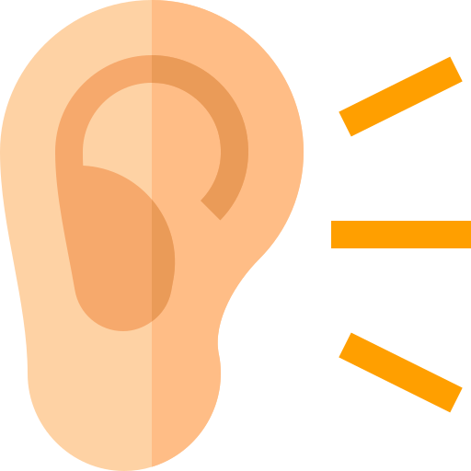
Design criterial
Shelter
Rocking
Rustling
Organic
Shelter is needed for unexpected weathers like raining or hot weather in park
Product engages our listening by hearing the sound of rustling gravel in park
Product is able to interact with users by allowing them to rock on the furniture
Organic element allows users to reconnect with the nature physically and visually
Notes:
And these are the design criteria, base on my observation in parks; shelter is needed for unexpected weathers like hot weather and rain. Also, organic elements design helps ppl to reconnect with nature physically and visually. Lastly, in order to have an ultimate destress in the park, seating on a rocking furniture which can delight our listening at the same time will be the best choice ever.

Slide 5
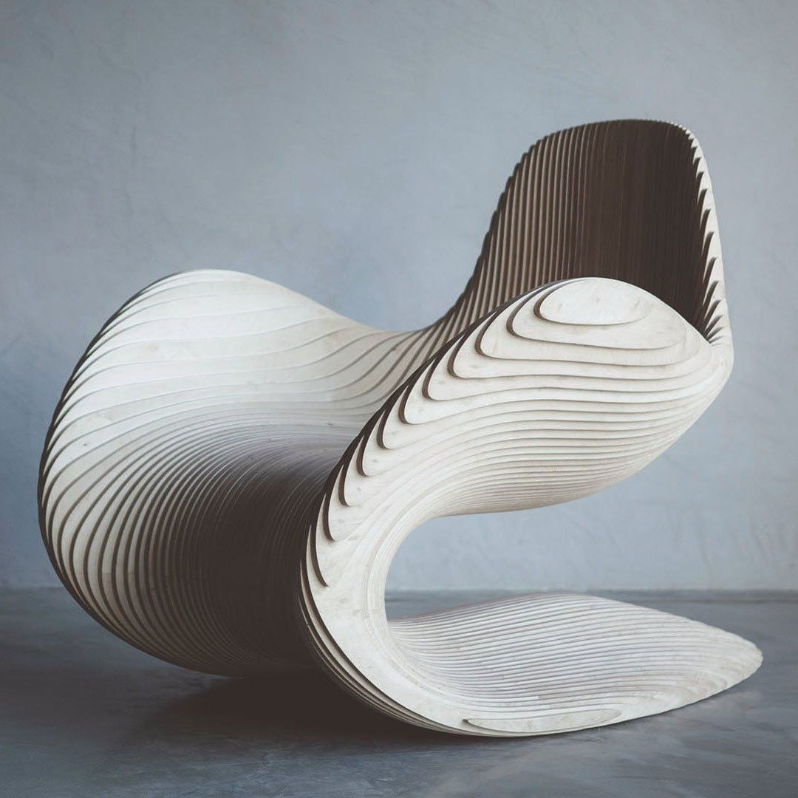
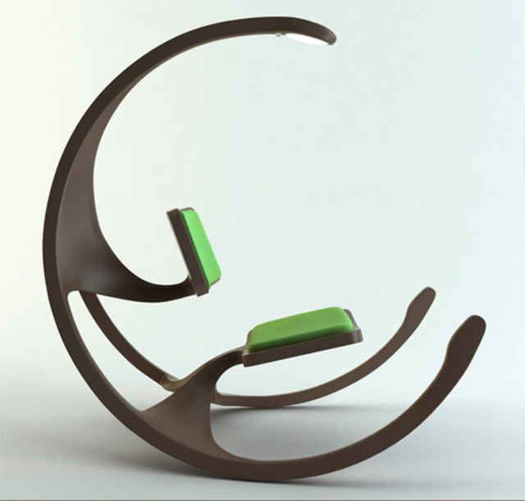
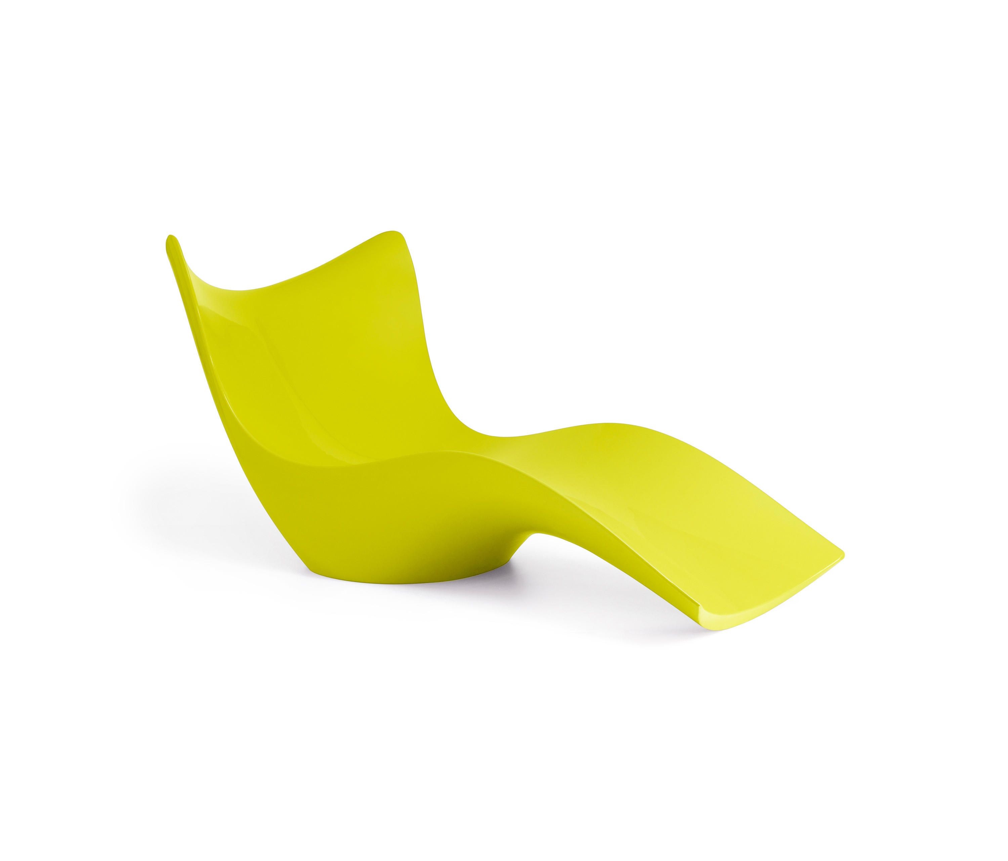
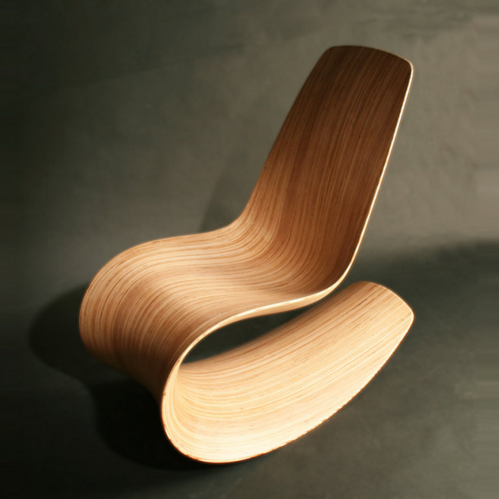
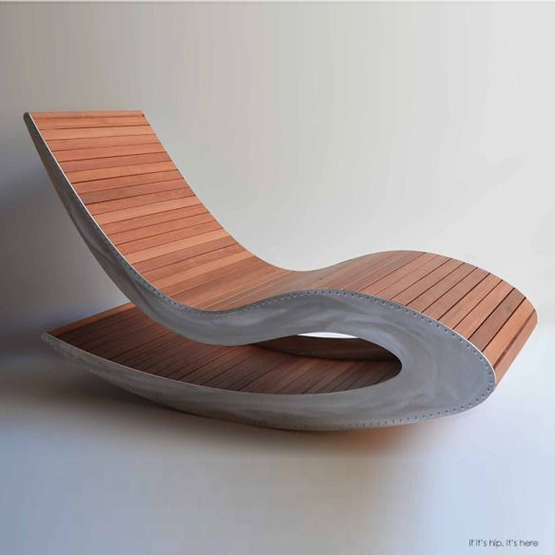
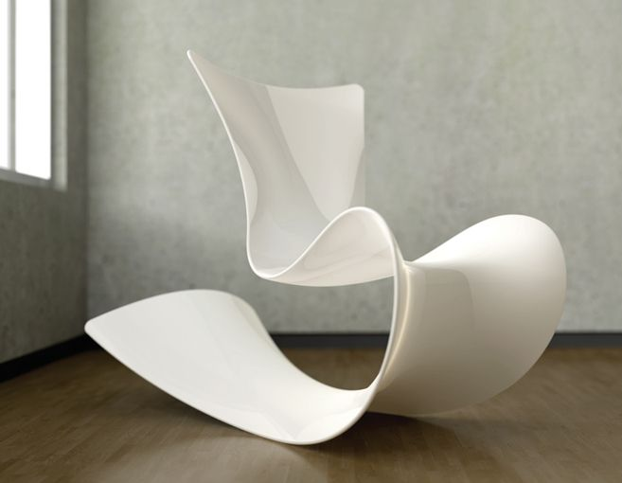
Mood board
Notes:
The key words for my mood board are fluid, concavity and convexity.

Slide 6
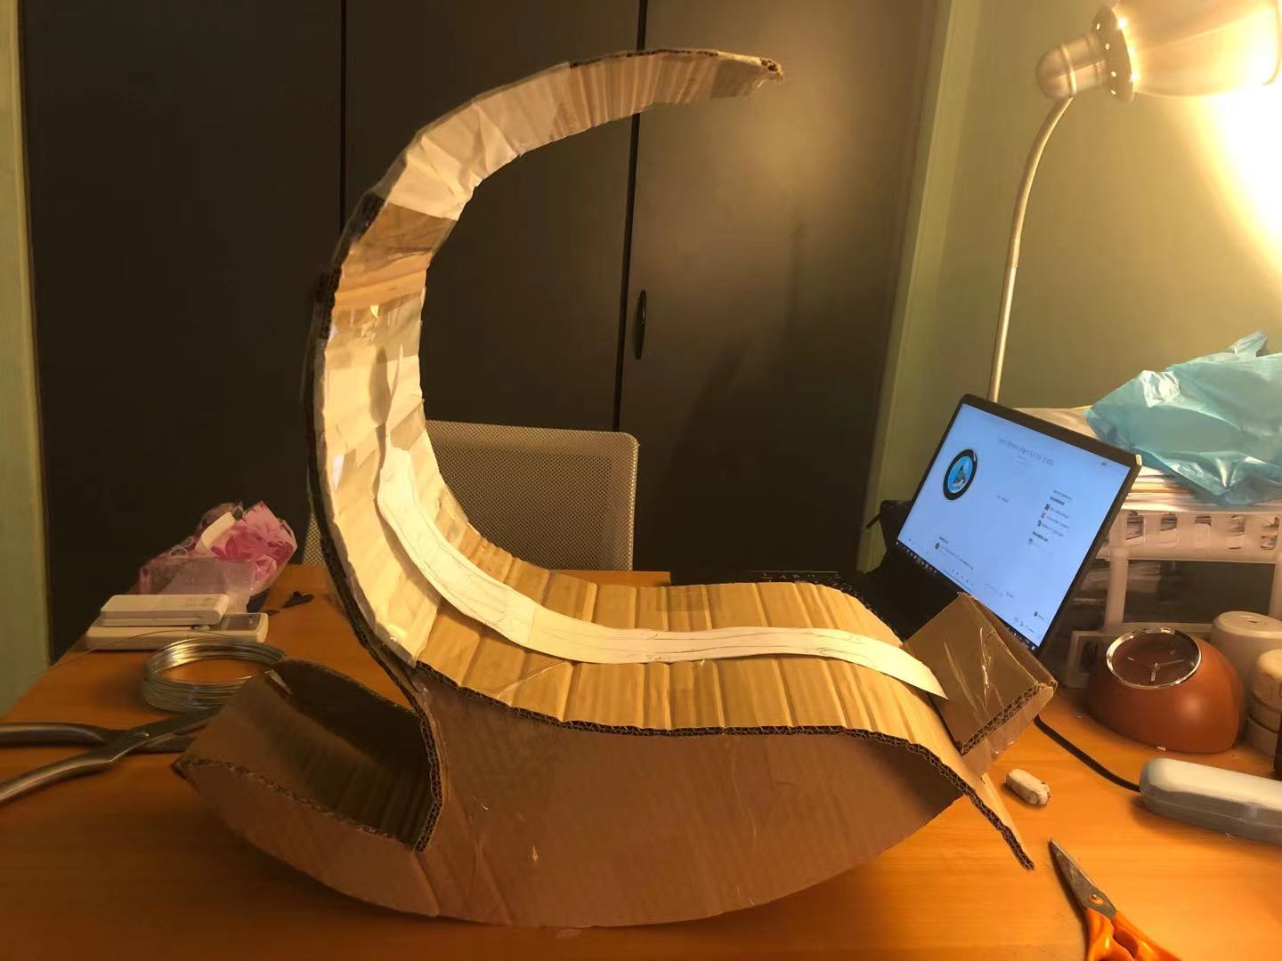
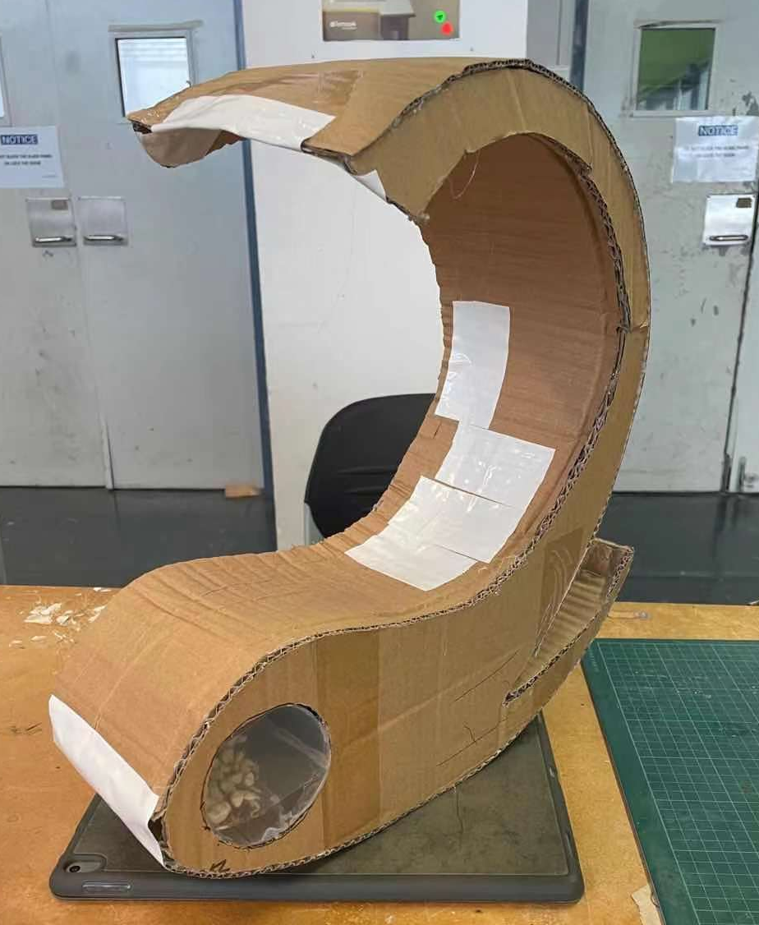
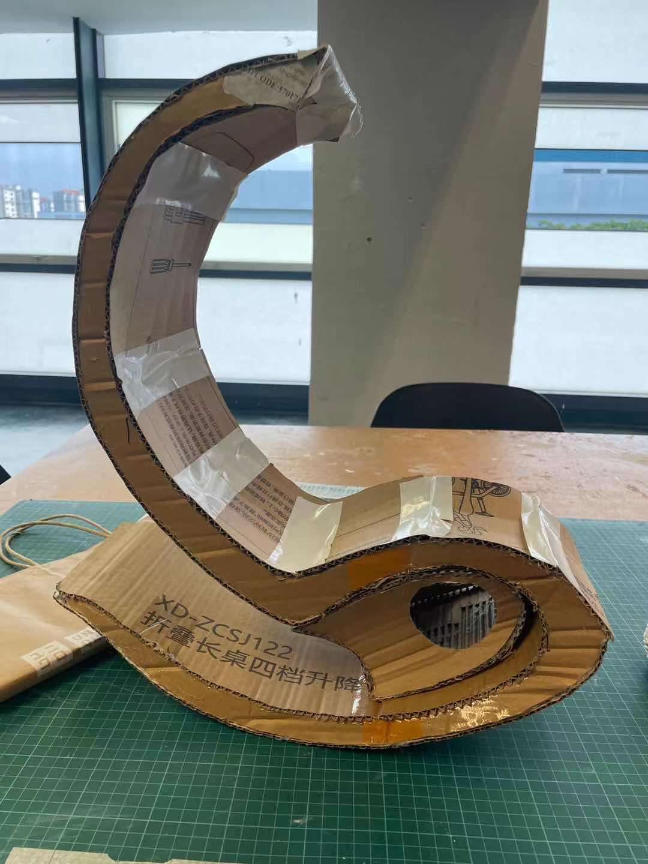
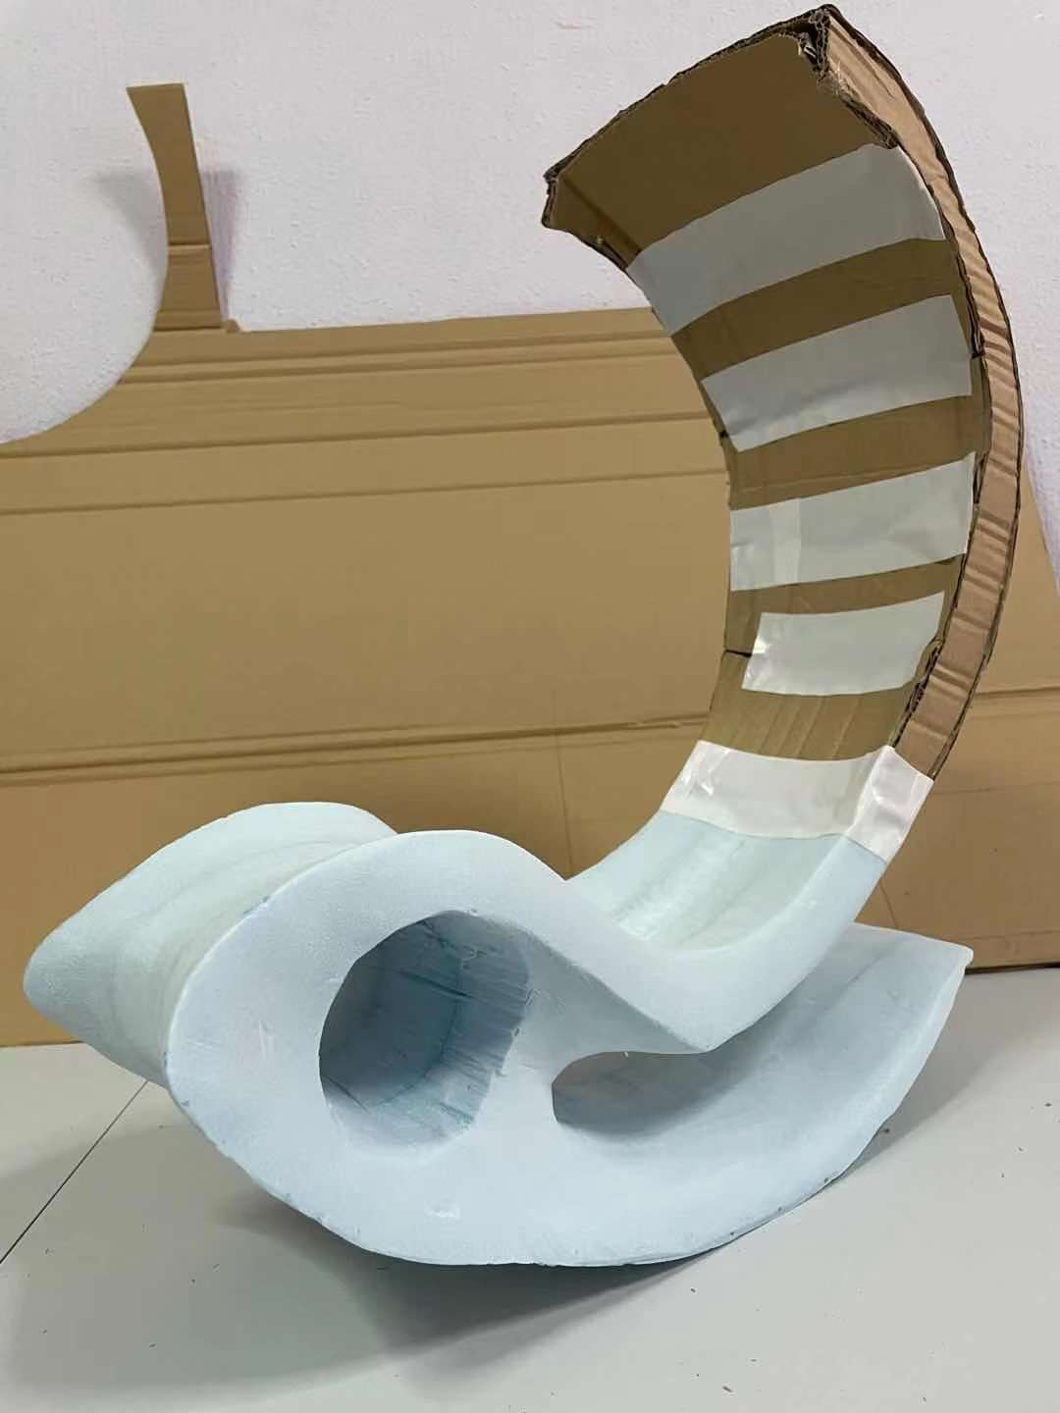
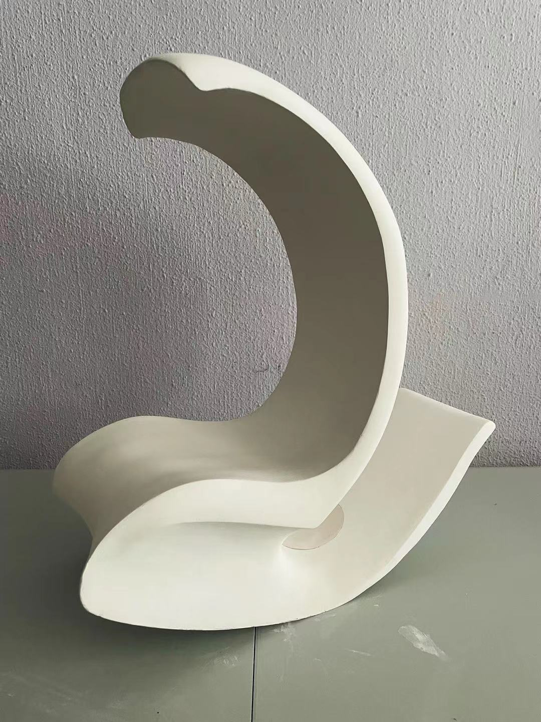
Design evolution
The process of model making
Notes:
And this is the general process of model making from interim 1 to the final product.

Slide 7
Insights
Concavity & convexity
Soundproof
Rocking motion
Wrapping by a “leaf”
Green color
Fluid and gentle curve movement brings a sense of organic
Green is the color of nature, it represents new life, growth and sustainability
The curve shelter provides certain soundproof effect
User can easily swing 25 degree forward and back ward on the furniture
It helps use to reconnect with nature by being wrapped by the green concave seat
Notes:
Moving on to insights. The overall shape of the furniture is organic, which shows the movement of fluid flow, concavity and convexity. And the concave shelter can not only provide a soundproof effect in the park, but the user can have a wonderful experience of being wrapped by a “leaf shelter” as well. Subsequently, the user can easily swing 25 degrees forward and backwards on the furniture. Lastly, the choice of colour, green is the colour of nature; it represents new life and growth.

Slide 8
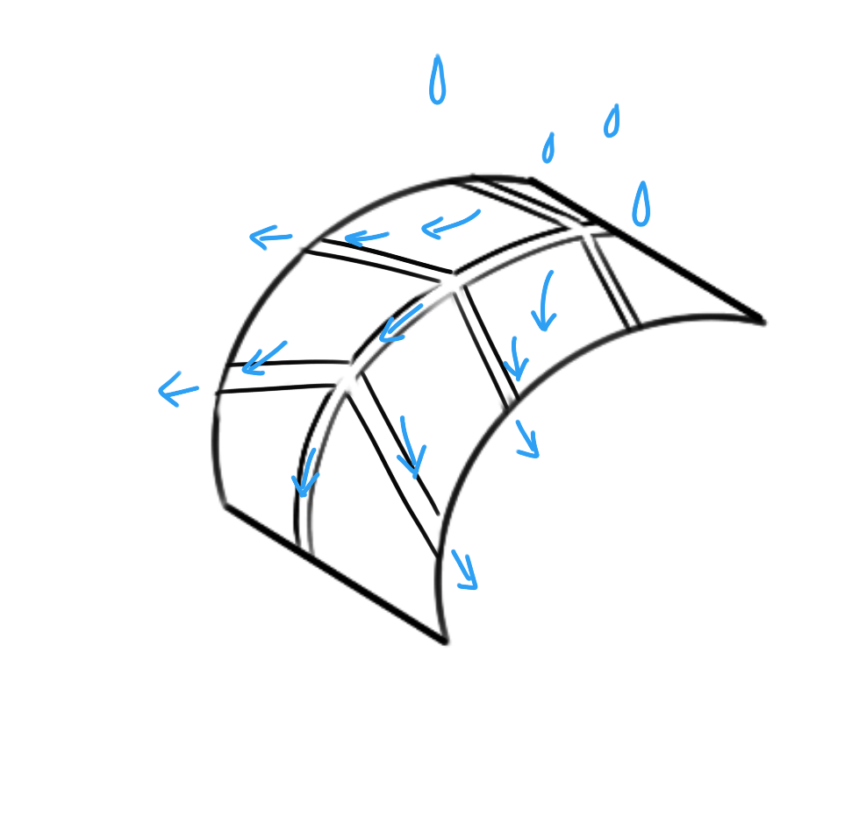
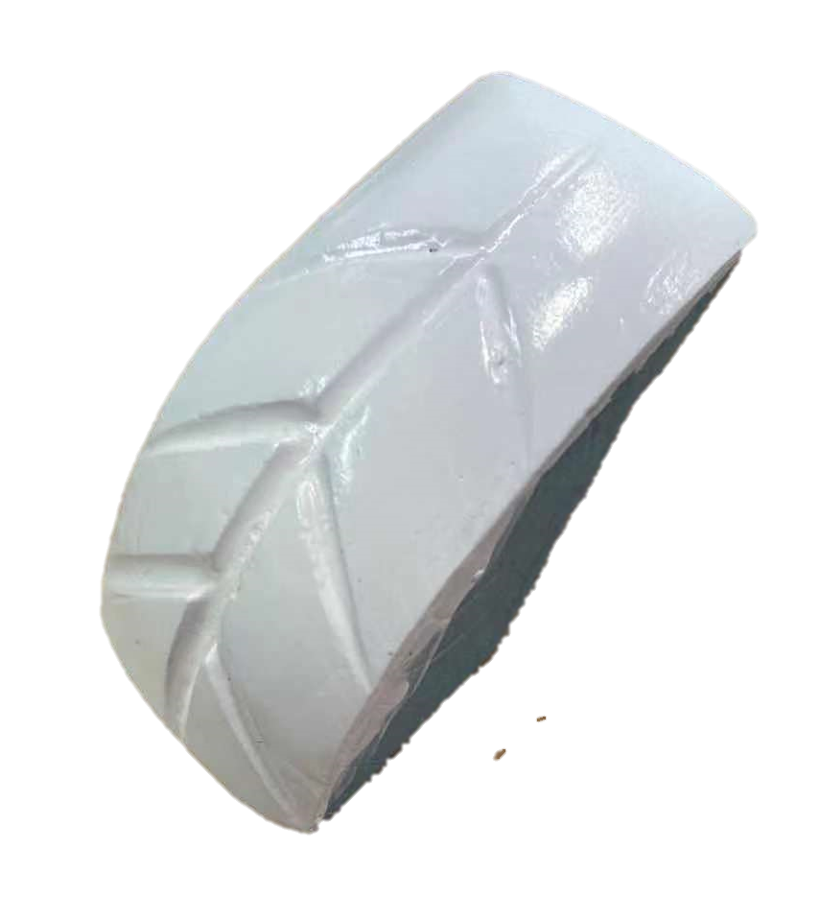
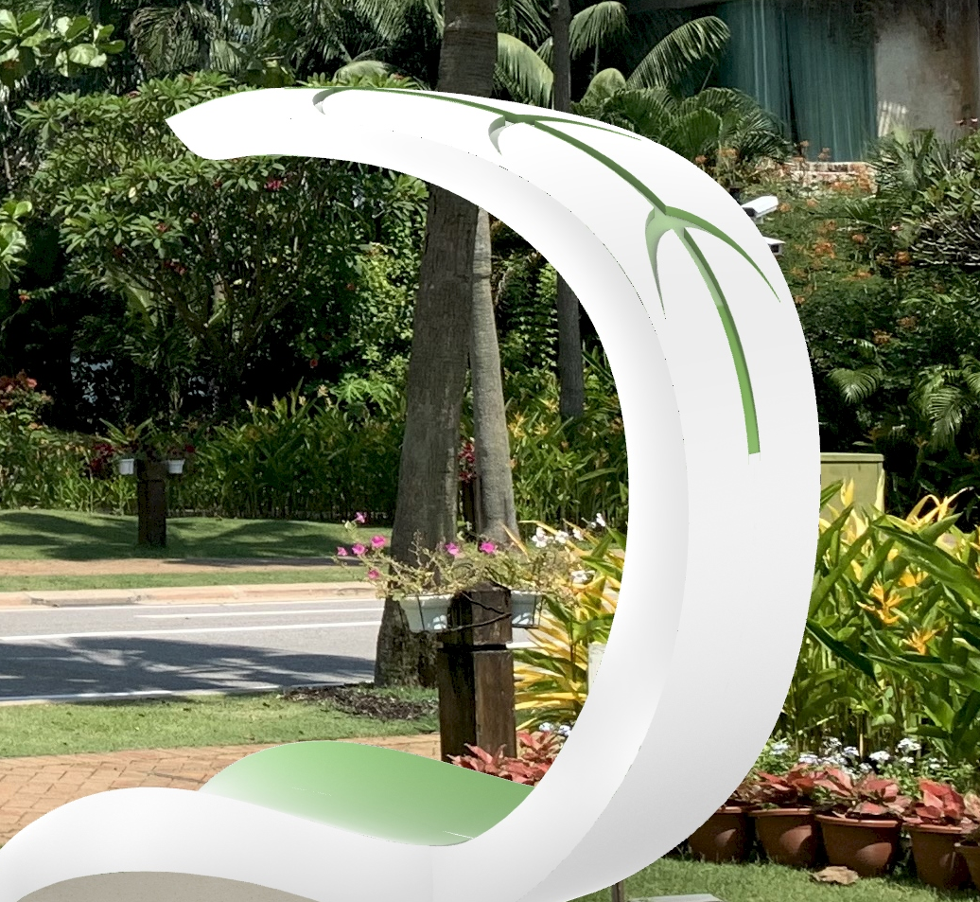
Leaf vein pattern shelter
The decoration of leaf vein pattern gives user a sense of nature visually
It also served as drainage, as in directing the flow of rain
Notes:
Next, the organic design of the leaf vein pattern on the shelter gives the user a sense of nature visually, and it also serves as a drainage to direct the flow of rain.

Slide 9
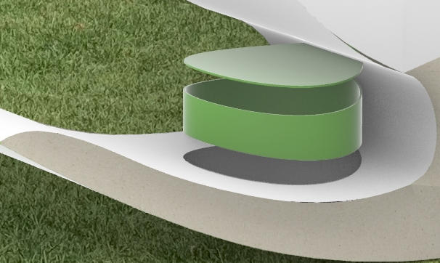
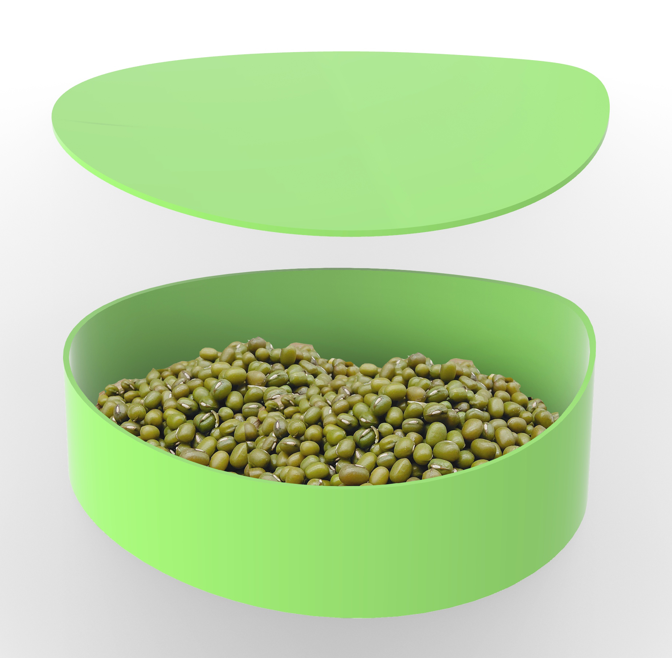
Rustling gravel
The rustling sound will be made while the furniture is swinging
Green beam and seed are used for mimicking the rustling sound in park
Notes:
Additionally, the rustling sound will be made while the furniture is swinging, and green beams and seeds are used to duplicate the rustling gravel in the park, which is a soft and relaxing sound to listen to.

Slide 10
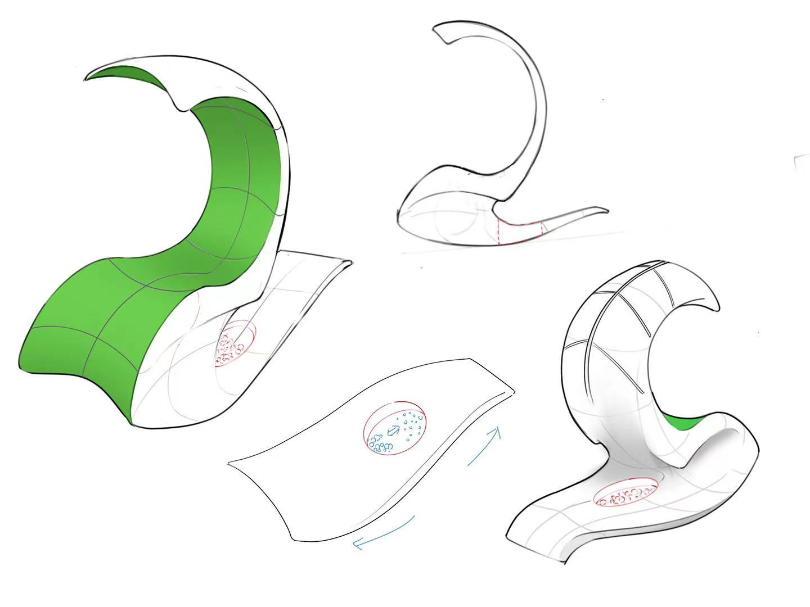
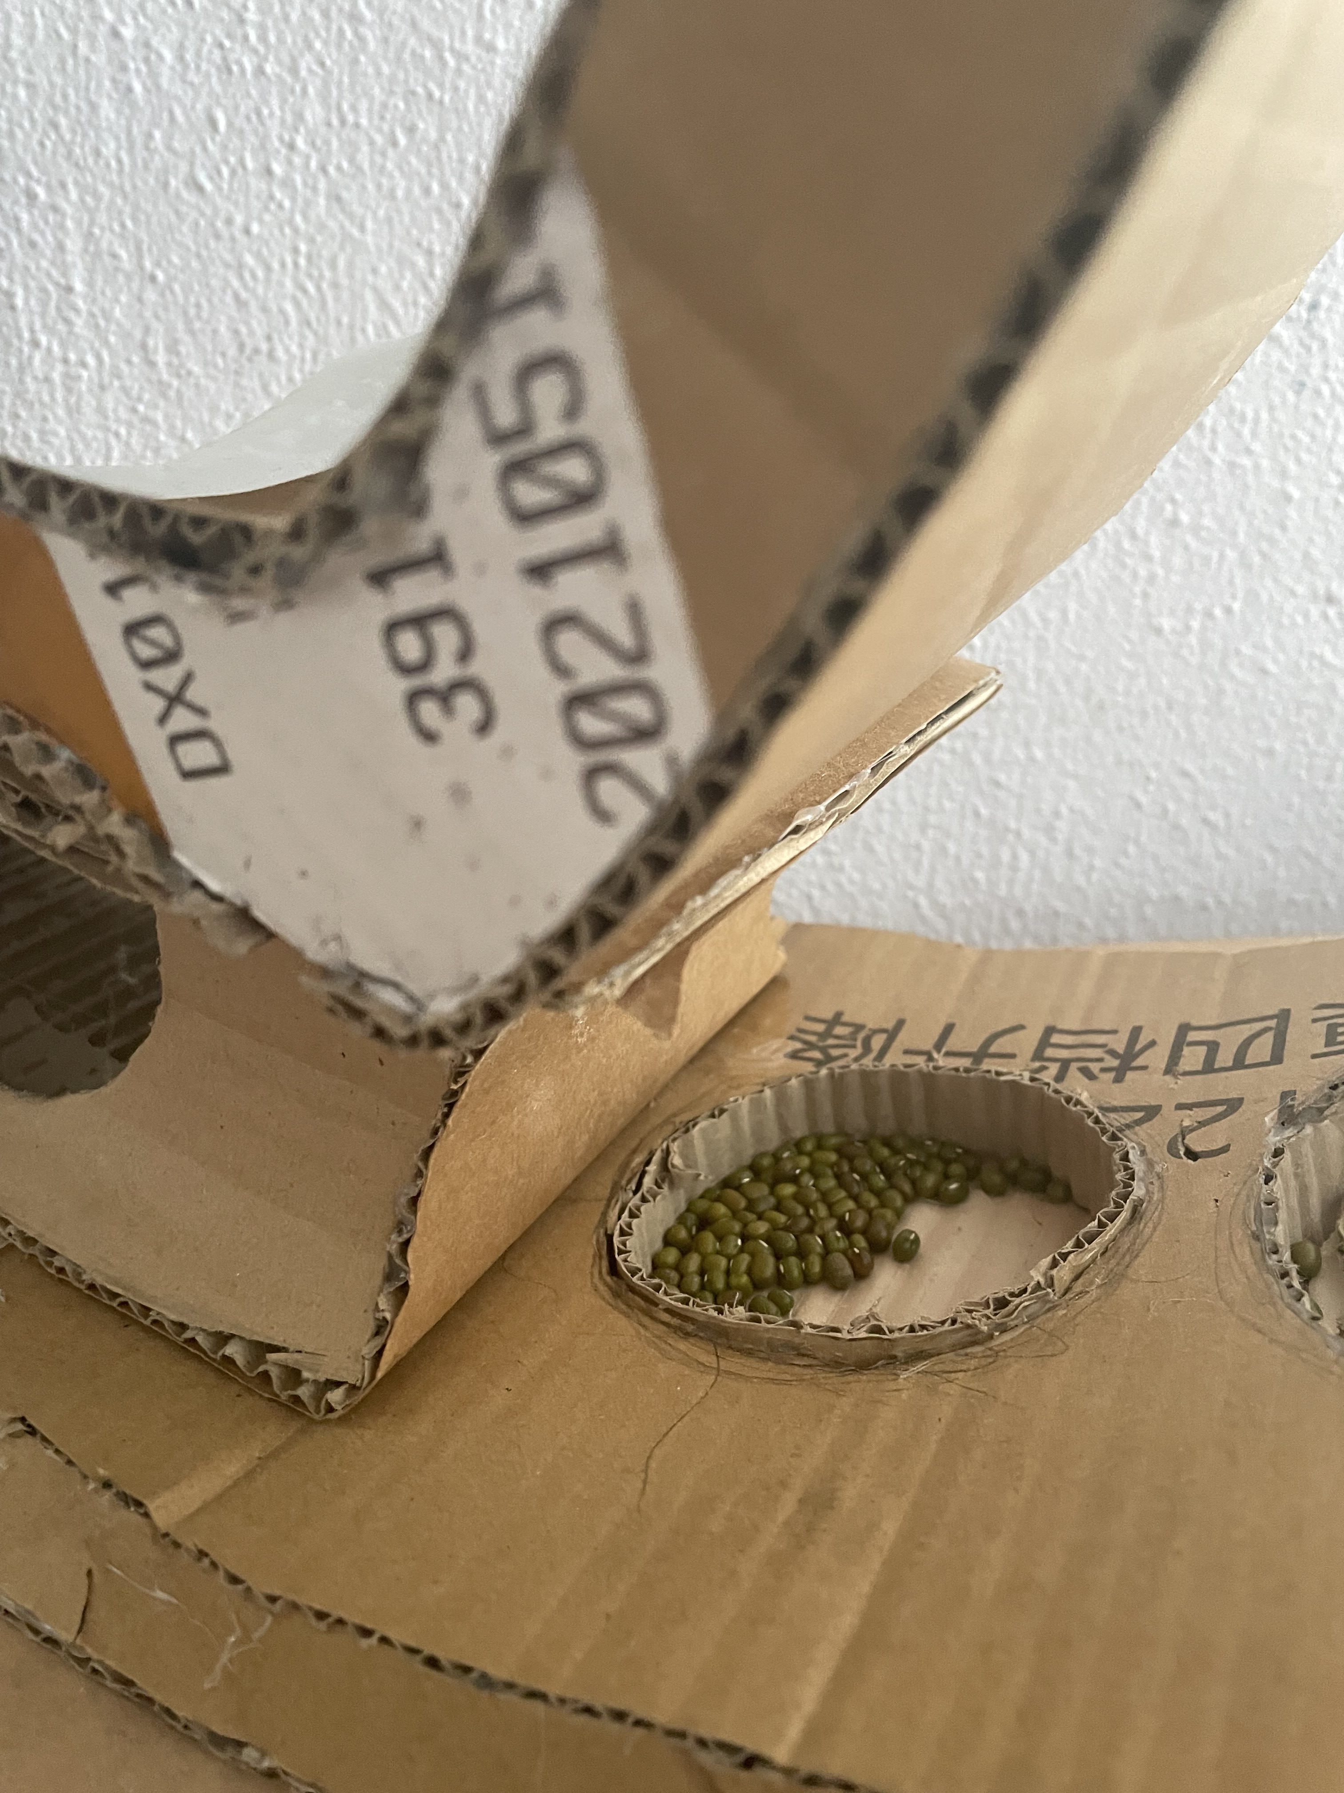
Rustling gravel
The sound generator is placed at the bottom in order to generate a bigger rage of swing in the container
The sound generator
Notes:
I put the sound generator at the bottom instead to generate a bigger range of swinging in the sound generator.

Slide 11
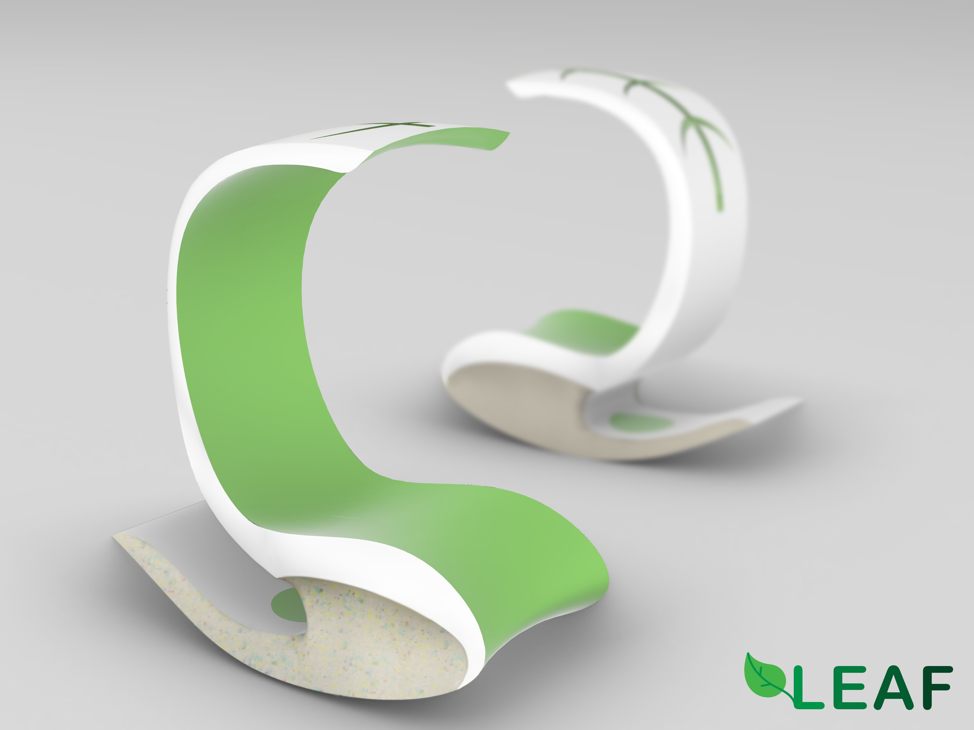

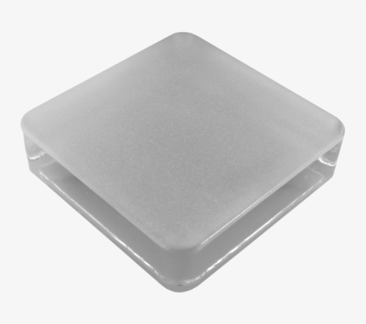
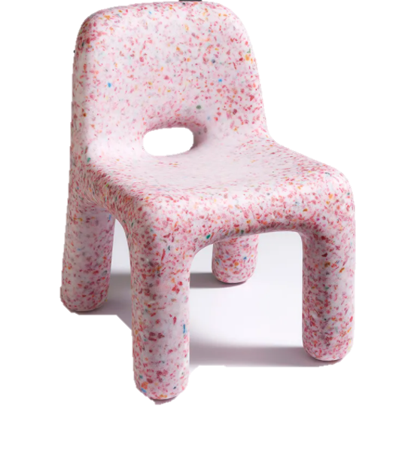
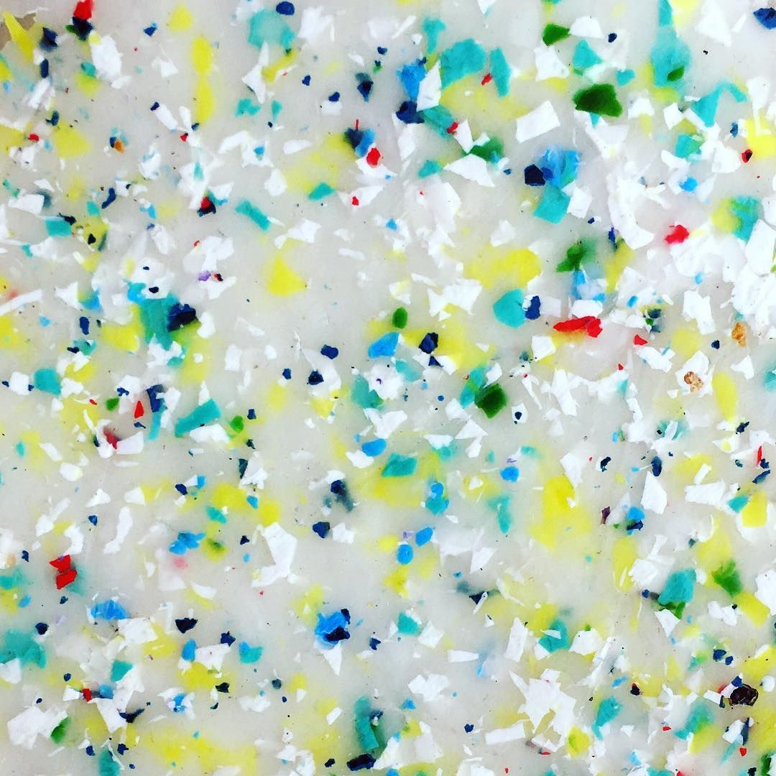
Materials
Acrylic (container)
sandblasted plastic (seat)
Recycle plastic mixed with concrete (base)
Notes:
Then The use of materials is all waterproof materials. The container is made of acrylic, and the seating area is made of sandblasted plastic. In terms of sustainability, I will be using recycled plastic mixed with concrete for the base. So that it will be are more stable and kind to the environment.

Slide 12
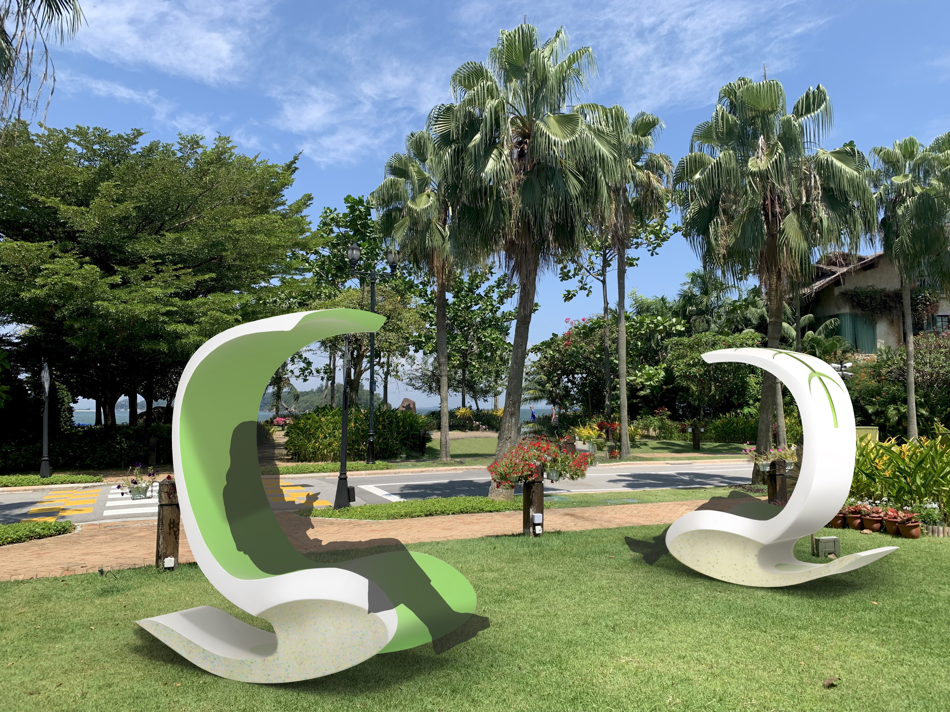
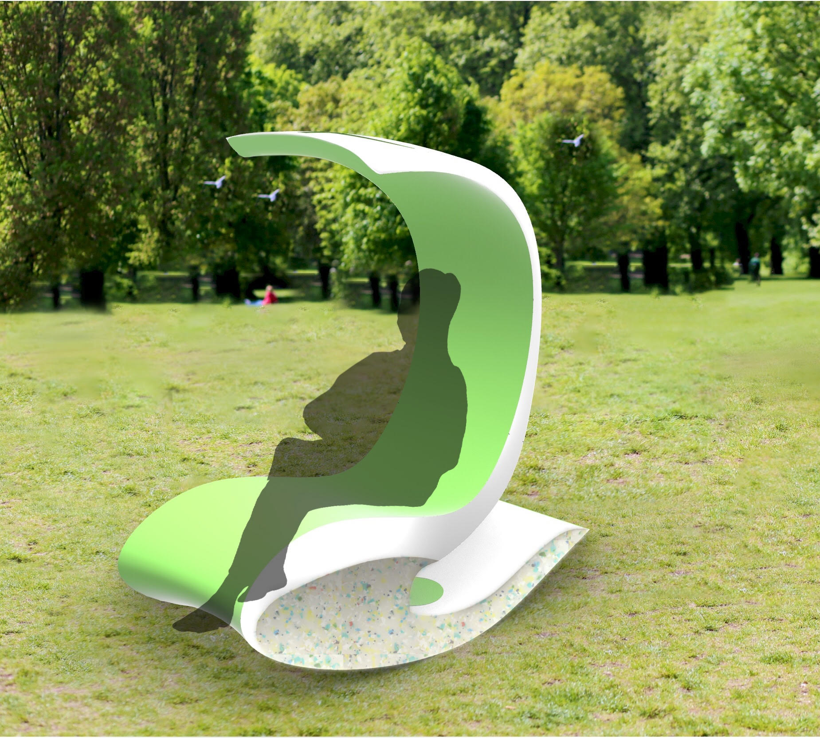
Contextual image
Notes:
This are the contextual image.

Slide 13
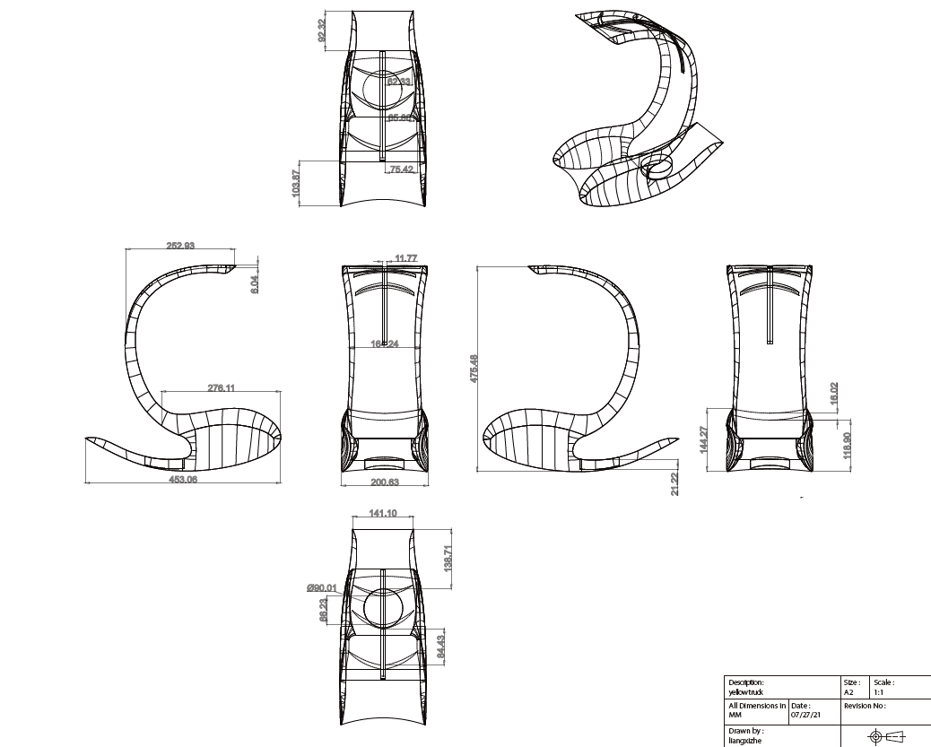
Orthographic drawing

Slide 14
Thanks !
Por favor, mantenha este slide para atribuição
Notes:
That’s all for my presentation, thank you for your time.

